Slide 1
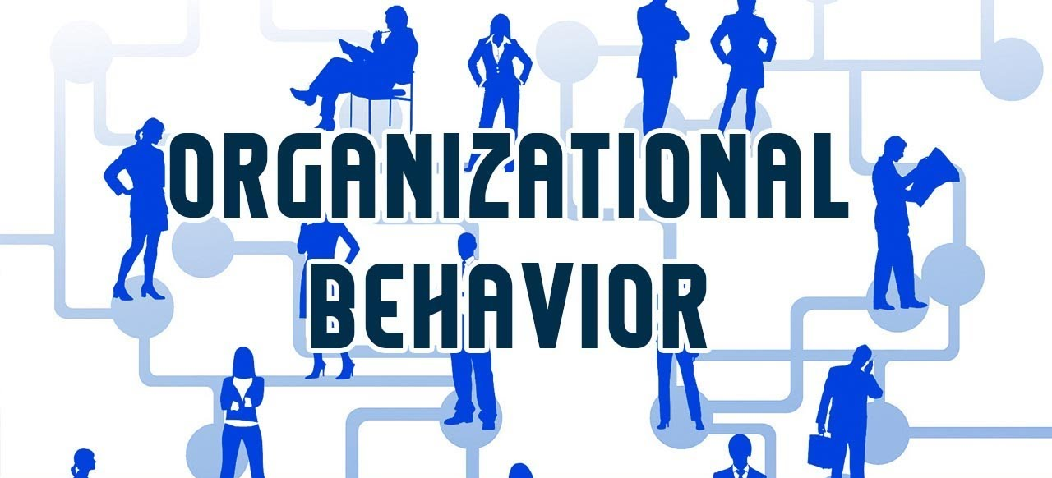


Attitudes and Job Satisfaction
Instructor: Dr. Muhammad Rafiq
Chapter 3: Organizational Behavior – 15th Edition

Slide 2
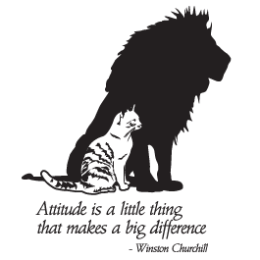
Attitude
Briefly defined, an “attitude” represents a tendency to respond in a favorable or unfavorable way to persons or objects in one’s environment.
For instance, when we say we “like” something or “dislike” something, we are in effect expressing an attitude toward the person or object.
Attitude could be defined also as a mental predisposition to act in a particular way towards a person or an object.
Notes:
Attitude is; manner, disposition, feeling, position, etc., with regard to a person or thing; tendency or orientation, especially of the mind

Slide 3
Attitudes
Attitudes are the feelings and beliefs that largely determine how employees will perceive their environment, commit themselves to intend actions and ultimately behave
Evaluative statements or judgments concerning objects, people, or events.
Less stable than values
Example: Believing that "AI can automate complex tasks."
Cognitive component The opinion or belief segment of an attitude.
Example: Feeling excited or anxious about AI-driven technologies
Affective Component The emotional or feeling segment of an attitude.
Behavioral Component An intention to behave in a certain way toward someone or something.
Example: Choosing to use AI-based tools because you believe they improve efficiency and you feel positively about technological progress
Notes:
An attitude is a positive or negative evaluation that predisposes a person to act in a certain way. An employee with an attitude problem might be hard to get along with, might gripe, and consistently resist new ideas. Understanding employee attitudes is important to managers because attitudes determine how people perceive the work environment, interact with others, and behave on the job. Effective managers strive to develop and reinforce positive attitudes among employees. Managers should recognize that negative attitudes can be the result of underlying problems in the workplace as well as a contributor to forthcoming problems.

Slide 4
Combining all three components together
These three components together create a comprehensive attitude toward something, and they are often interdependent.
For example, positive thoughts about a product (cognitive) may generate positive feelings (affective) and lead to purchasing behavior (behavioral).

Slide 5
Some issues that matter in the study of attitudes
What are the main components of attitude?
How consistent are attitudes?
Does behavior always follow from attitudes?
What are the main job attitudes?
How are employees' attitudes measured?
What are the importance of attitudes to workplace diversity?
Notes:
Here are precise answers to your questions:
1. **What are the main components of attitude?**
The main components of attitude are:
- **Cognitive**: Beliefs or thoughts about something.
- **Affective**: Emotional feelings toward something.
- **Behavioral**: Intentions or actions related to the object.
2. **How consistent are attitudes?**
Attitudes are generally consistent but not always perfectly aligned. While cognitive and affective components typically influence behavior, external factors, social norms, or situational constraints can create inconsistencies between attitudes and behaviors.
3. **Does behavior always follow from attitudes?**
No, behavior does not always follow from attitudes. Various factors, such as situational constraints, social pressures, or lack of opportunity, can prevent behaviors from aligning with personal attitudes.
4. **What are the main job attitudes?**
Key job attitudes include:
- **Job Satisfaction**: Positive or negative feelings about one’s job.
- **Organizational Commitment**: Emotional attachment and loyalty to the organization.
- **Job Involvement**: The degree to which a person identifies with their job.
- **Perceived Organizational Support**: Beliefs about how much the organization values the employee.
- **Employee Engagement**: Enthusiasm and dedication toward work.
5. **How are employees' attitudes measured?**
Employee attitudes are typically measured through:
- **Surveys and Questionnaires**: Standardized tools like the Job Descriptive Index (JDI) or Employee Engagement Surveys.
- **Interviews**: Structured or semi-structured discussions about job experiences.
- **Focus Groups**: Group discussions to gauge collective employee attitudes.
- **Observation**: Monitoring behaviors that reflect job attitudes (e.g., turnover, absenteeism).
6. **What is the importance of attitudes to workplace diversity?**
Attitudes toward workplace diversity are crucial because they influence inclusivity, collaboration, and morale. Positive attitudes can foster an environment of acceptance and respect, while negative attitudes can lead to discrimination, bias, and conflict. Managing and improving attitudes toward diversity enhances team performance and organizational effectiveness.

Slide 6
How consistent are attitudes
People change their attitudes although attitudes are relatively stable mental predispositions.
Sometimes, attitudes change even very quickly as if it does not have any stability.
When there is inconsistency, people seek to return to a level of equilibrium state.

Slide 7
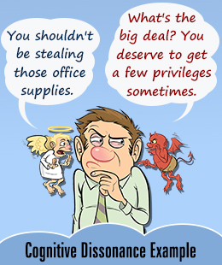
The Theory of Cognitive Dissonance
Cognitive Dissonance
Any incompatibility between two or more attitudes or between behavior and attitudes.
Individuals seek to reduce this gap, or “dissonance”
Desire to reduce dissonance depends on
Importance of elements creating dissonance
Degree of individual influence over elements
Rewards involved in dissonance
Notes:
Psychologist Leon 1957 proposed this theory

Slide 8
Types of Work Attitudes
Job Satisfaction A collection of positive feelings that an individual holds toward his or her job.
Job Involvement Identifying with the job, actively participating in it, and considering performance important to self-worth.
Organizational Commitment Identifying with a particular organization and its goals, and wishing to maintain membership in the organization (Affective, Normative, and Continuance Commitment)
Notes:
Job satisfaction is a positive attitude to one’s job. People experience this attitude when their work matches their needs and interests and they like their co-workers. Job satisfaction also occurs when working conditions and rewards are satisfactory and when people have positive relationships with supervisors.
Research shows that the link between job satisfaction and performance is small and is affected by other factors. Satisfaction varies according to the amount of control the employee has (Autonomy). Managers play an important role in whether employees have positive or negative attitudes about their jobs.
Organizational commitment is loyalty to and engagement in one’s organization. Most managers want to enjoy the benefits of loyal, committed employees, including low turnover and willingness to do more than the job’s basic requirements.
A recent study of 650,000 employees in global organizations found that companies with highly committed employees outperformed the industry average by 6 percent. High motivation and engagement that comes with organizational commitment are essential to the success of knowledge-based organizations that depend on creativity.

Slide 9
Types of Work Attitudes (Cont.)
Perceived Organizational Support (POS)
Degree to which employees feel the organization cares about their well-being.
Employee Engagement
An individual’s involvement with, satisfaction with, and enthusiasm for the organization.

Slide 10
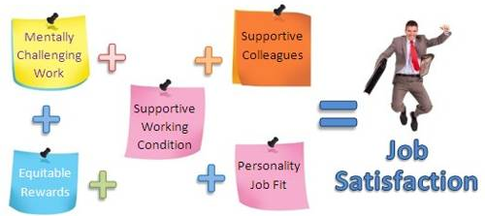
Job Satisfaction
A positive feeling about a job resulting from an evaluation of its characteristics—is clearly broad.
Measuring Job Satisfaction
Single global rating
Summation score
How Satisfied Are People in Their Jobs?
In general, people are satisfied with their jobs.
Depends on factors of satisfaction—tend to be less satisfied with pay and promotion opportunities.

Slide 11
An Application: Attitude Surveys
Attitude Surveys
Producing responses from employees through questionnaires about how they feel about their jobs, work groups, supervisors, and the organization.

Slide 12
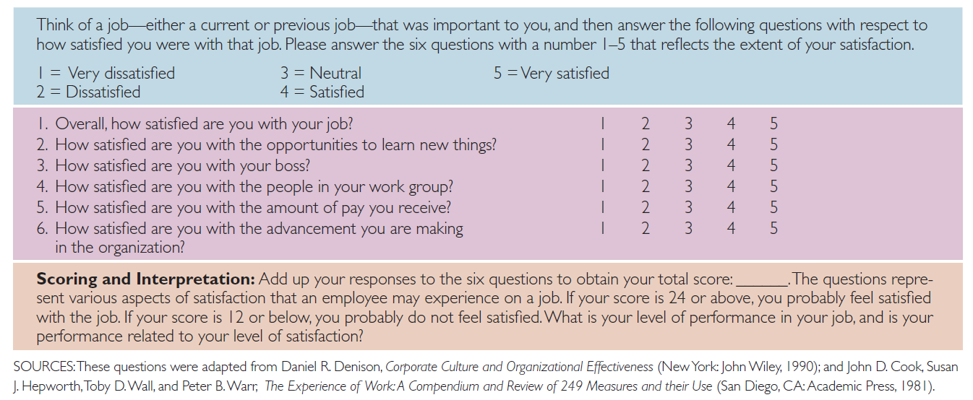
Rate Your Job Satisfaction

Slide 13
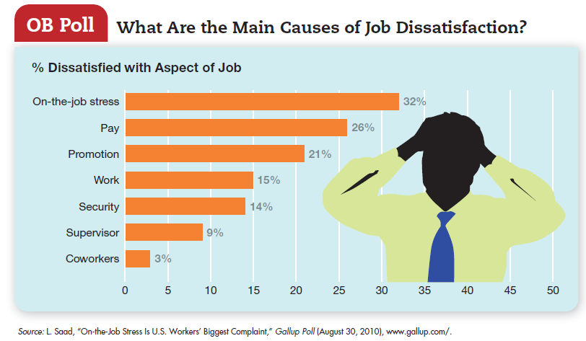

Slide 14
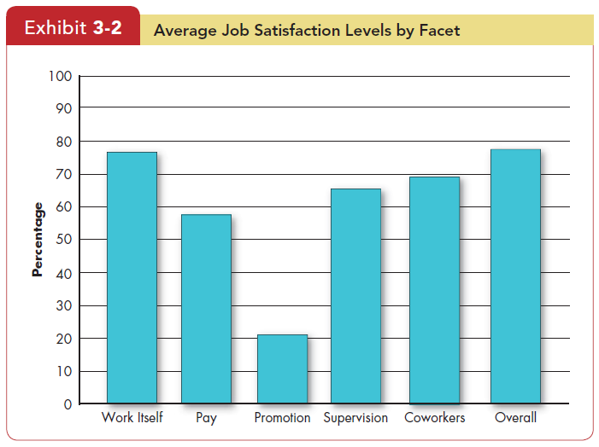
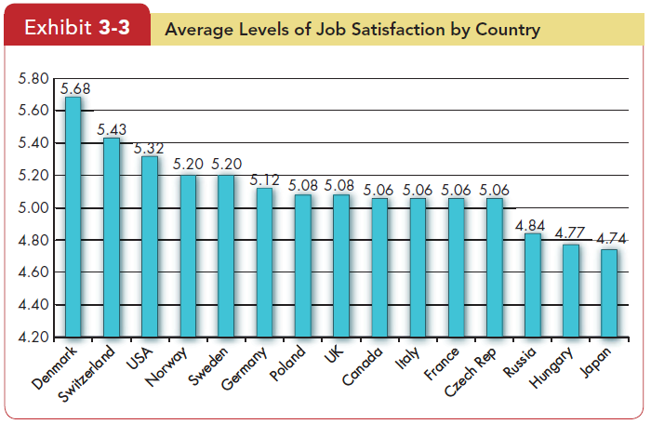

Slide 15
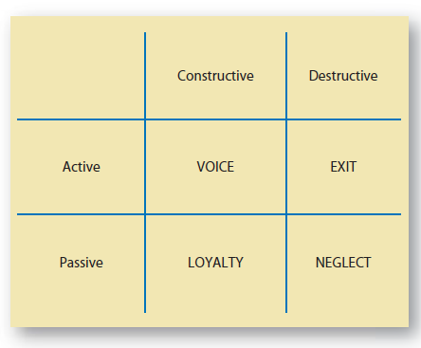
The Impact of Satisfied and Dissatisfied Employees on the Workplace
Voice
Active and constructive attempts to improve conditions.
Exit
Behavior directed toward leaving the organization.
Loyalty
Passively waiting for conditions to improve.
Neglect
Allowing conditions to worsen.

Slide 16
The Effect of Job Satisfaction on Employee Performance
Satisfaction and Productivity
Satisfied workers are more productive AND more productive workers are more satisfied!
Worker productivity is higher in organizations with more satisfied workers.
Satisfaction and Absenteeism
Satisfied employees have fewer avoidable absences.
Satisfaction and Turnover
Satisfied employees are less likely to quit.
Organizations take actions to retain high performers and to weed out lower performers.

Slide 17

Job Satisfaction and Organizational Citizenship Behavior
Satisfaction and OCBs
Work behavior can be seen in terms of in-role and extra-role behavior.
Willingness to engage in extra-role is indicative of high OCB
OCB is willingness to go beyond the normal expectations of their job.
OCB is due to high level of Job Satisfaction and commitment.
Notes:
Satisfied employees who feel fairly treated by and are trusting of the organization are more willing to engage in behaviors that go beyond the normal expectations of their job.

Slide 18
Job Satisfaction and Customer Satisfaction
Satisfaction and Customer Satisfaction
Satisfied workers provide better customer service
Satisfied employees increase customer satisfaction because:
They are more friendly, cheerful, and responsive.
They are less likely to turnover, which helps build long-term customer relationships.
They are experienced.
Dissatisfied customers increase employee job dissatisfaction.

Slide 19
Supplementary Material
Video 1: https://www.youtube.com/watch?v=qXayH99GbCw
Video 2: https://www.youtube.com/watch?v=8DOR3AnyLOQ
Video 3: https://study.com/academy/lesson/what-is-employee-satisfaction-examples-factors-quiz.html
Case: GACL: Balancing Employee Satisfaction and Productivity. Author: Kanupriya Katyal, Jagrook Dawra
Case: Treadway Tire Company: Job Dissatisfaction and High Turnover at the Lima Plant. Author: C. Wickham Skinner, Heather Beckham
Cases available on Slate

